Slide 1
Cloud based service offerings
By
Tabinda Ali Shah Zaman

Slide 2
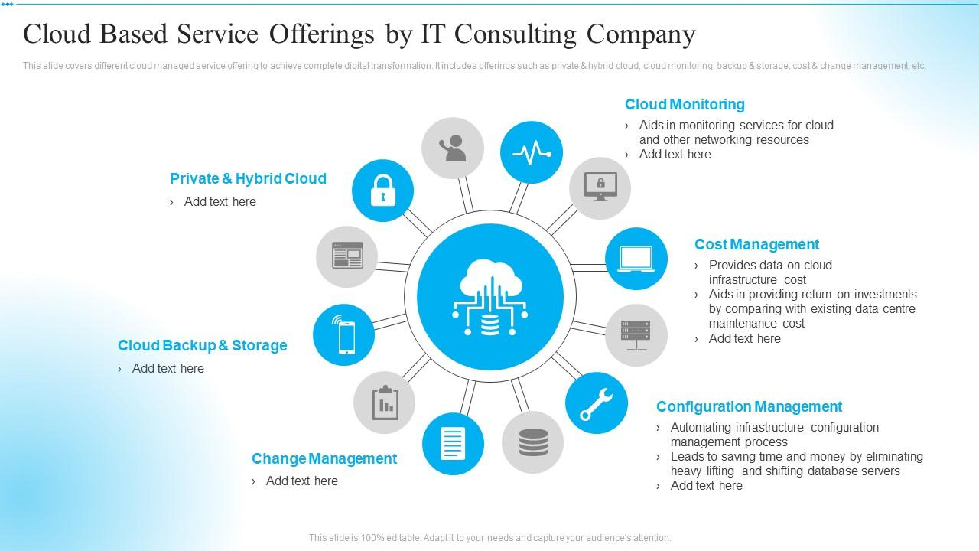

Slide 3
Cloud Monitoring
Real-Time Visibility: Cloud monitoring provides real-time visibility into the performance and health of cloud resources.
Proactive Issue Detection: It allows for the early detection of issues, enabling proactive management and minimizing downtime.
Resource Utilization Tracking: Monitoring tools track resource utilization, helping optimize performance and cost efficiency.

Slide 4
Cost Management
Usage Analytics: Cost management tools analyze usage patterns, providing insights into resource consumption.
Budgeting and Forecasting: Businesses can set budgets and forecasts to control and predict cloud-related expenses.
Cost Allocation: Tools facilitate the allocation of costs to specific departments or projects, promoting accountability.

Slide 5
Configuration Management
Automated Configuration: Configuration management automates the setup and maintenance of cloud resources.
Consistency Across Environments: It ensures consistency in configurations across different environments, reducing errors and enhancing reliability.
Version Control: Configuration changes are tracked and version-controlled, allowing for easy rollback and auditability.

Slide 6
Change Management
Controlled Deployment: Change management processes ensure controlled and documented deployment of changes in cloud environments.
Risk Mitigation: Changes are assessed for potential risks, and mitigation strategies are implemented to prevent disruptions.
Documentation and Auditing: Comprehensive documentation and auditing mechanisms support regulatory compliance and accountability.

Slide 7
Cloud Backup and Storage
Automated Backups: Cloud backup services offer automated and scheduled backups for data protection.
Redundant Storage: Data is often stored redundantly in multiple locations, ensuring resilience against data loss.
Scalable Storage: Cloud storage can scale dynamically to accommodate growing data volumes without significant upfront investments.

Slide 8
Private and Hybrid Cloud
Private Cloud Security: Private clouds offer enhanced security and control as they are dedicated to a single organization.
Hybrid Cloud Flexibility: Hybrid clouds combine private and public cloud elements, providing flexibility in managing workloads.
Data Sensitivity Considerations: Organizations can choose deployment models based on data sensitivity, keeping critical data on private clouds while leveraging public cloud scalability.

Slide 9
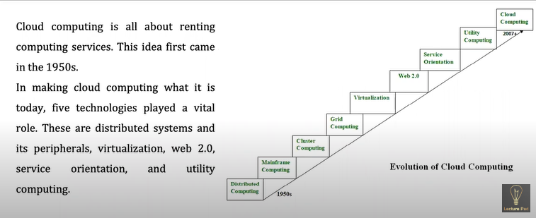
Evolution of Cloud Computing

